Slide 1
Final Project Presentation
Matt Purkeypile, Aryaz Zomorodi, Subhabrata Ganguli
February 2024

Slide 2
Table of Contents
Problem Statement
Independent and Dependent Variables
Data Exploration
Classifiers
Metrics for Classifiers
Conclusion

Slide 3
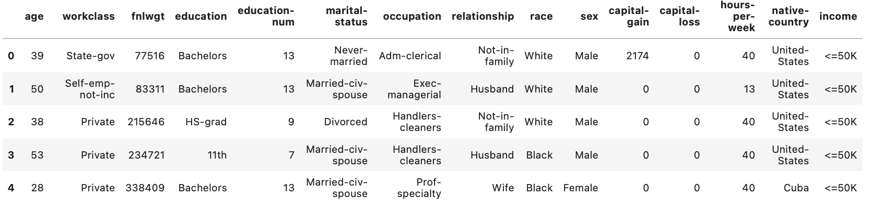
Problem Statement
An examination of US Census data to determine if there are demographic factors that influence income.
Data was selected from the UC Irvine Machine Learning Repository,
Data Head:

Slide 4
Independent and Dependent Variables
We have considered the following potential features which affect “income”:
Education
Race
Occupation
Age Category (age divided into bins of 10)
Number of Years in Education
The correlations between these factors and income are shown in the next slide.

Slide 5
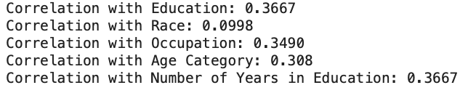
Correlation Between Factors & Income
(dropped)

Slide 6
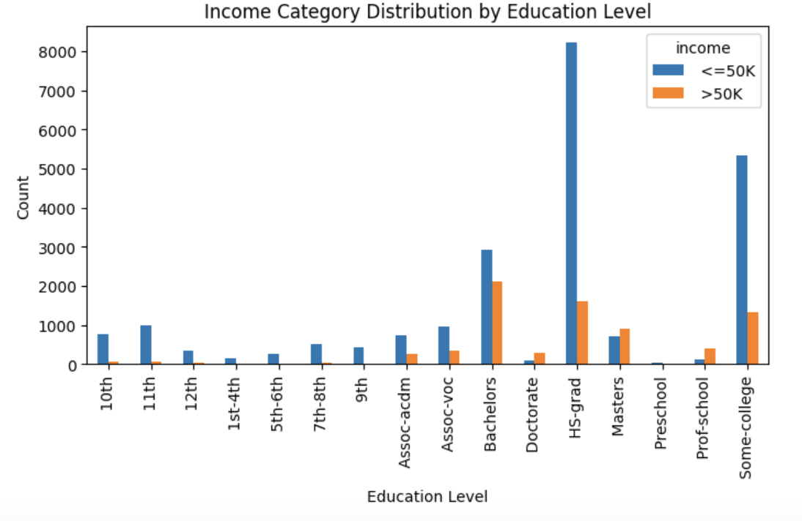
Education vs Income

Slide 7
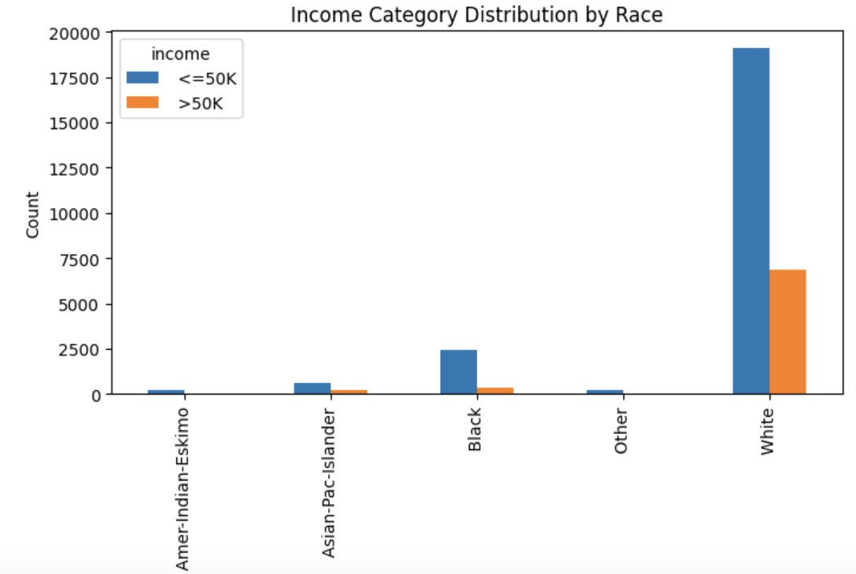
Race vs Income

Slide 8
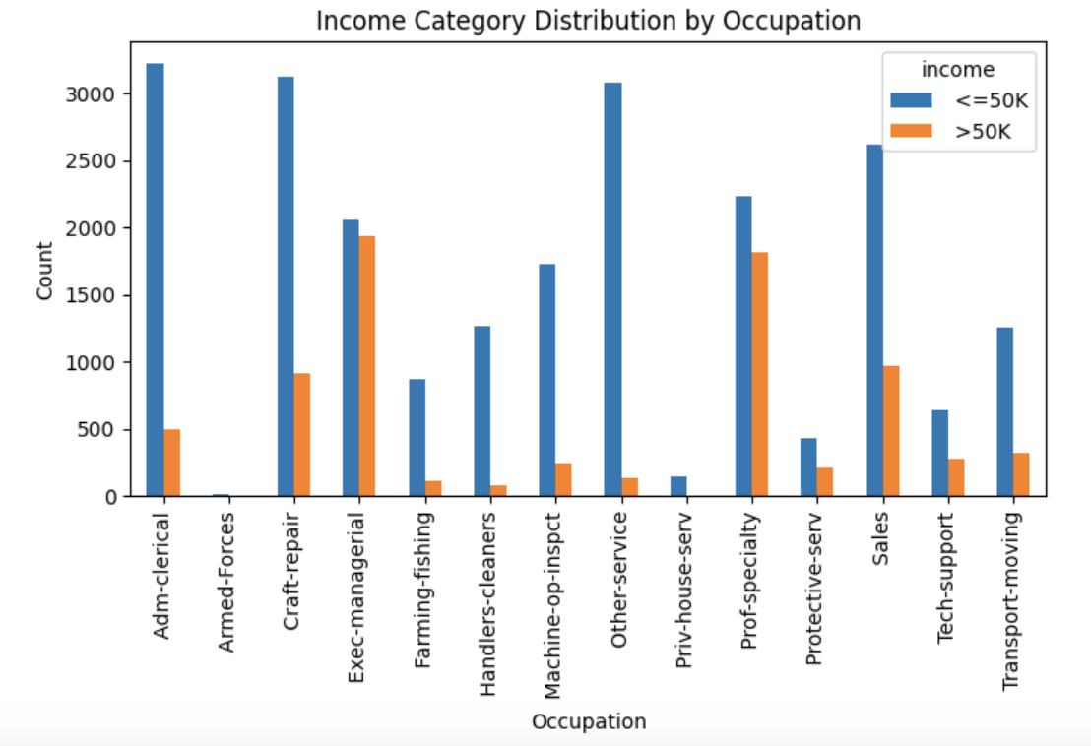
Occupation vs Income

Slide 9
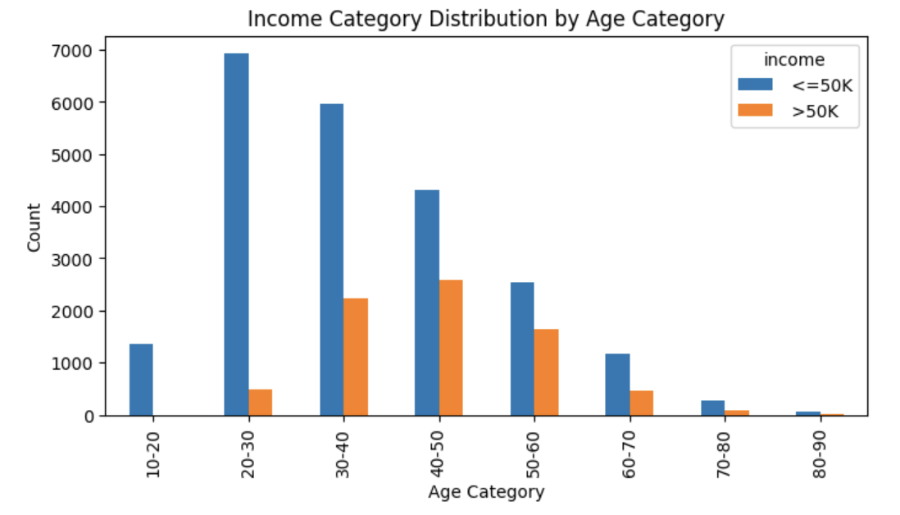
Age Category vs Income

Slide 10
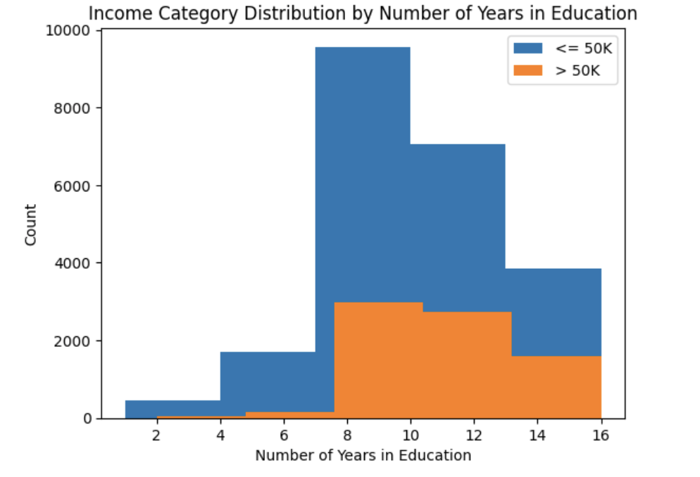
No. of Years in Education vs Income

Slide 11
Classifiers
We have chosen five classifiers for our analysis:
Decision Tree Classifier
Random Forest Classifier
Gradient Boosting Machine Classifier
Support Vector Machine Classifier
Logistic Regression

Slide 12
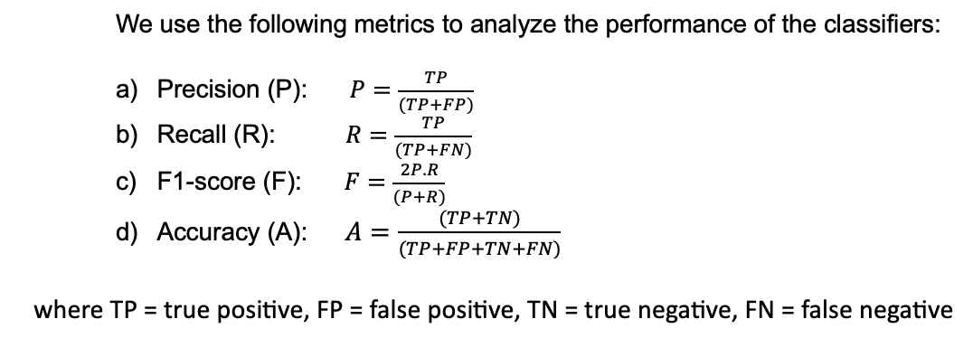
Metrics for Classifiers
Precision: how many of the items our model labeled as positive are actually relevant
Recall: how many of the actual positive items our model managed to capture
F1-score: how well the model balances precision and recall. High F1-score indicates that the model has both high precision and high recall
Accuracy: proportion of correctly classified instances (both positive and negative) out of the total instances

Slide 13
Metrics for Classifiers
Income | Metrics | SVC | Logistic Regression | Decision Tree Classifier | Random Forest Classifier | Gradient Boosting Machines Classifier
<= 50K | Precision | 0.82 | 0.82 | 0.82 | 0.82 | 0.83
 | Recall | 0.93 | 0.93 | 0.93 | 0.92 | 0.92
 | F1-score | 0.87 | 0.87 | 0.87 | 0.87 | 0.87
> 50K | Precision | 0.65 | 0.66 | 0.65 | 0.65 | 0.64
 | Recall | 0.39 | 0.39 | 0.41 | 0.41 | 0.43
 | F1-score | 0.49 | 0.49 | 0.50 | 0.50 | 0.51
 | Accuracy | 0.79 | 0.79 | 0.79 | 0.79 | 0.79

Slide 14
Conclusion
The Adult dataset was selected for the final project.
Initial list of possible independent variables was created: ‘education’, ‘race’, ‘occupation’, ‘age_category’, ‘education-num’
‘race’ due to low correlation with ‘income’.
Five classifiers were used for analysis - for all of them the performance metrics were similar:
accuracy ~79% - 80%
precision, recall and F1-score was lower for income >= 50K
Can use any of the classifiers for prediction.
Future Work: Study why all classifiers giving similar results.

Slide 15
Backup Slides

Slide 16
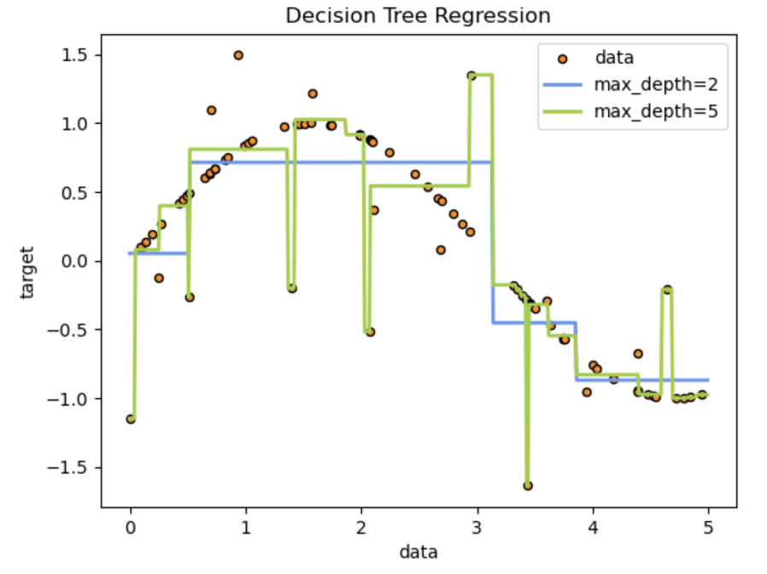
Decision Tree Classifier
Supervised learning method used for classification and regression
Creates a model that predicts the value of a target variable by learning simple decision rules inferred from the data features.
A tree can be seen as a piecewise constant approximation

Slide 17
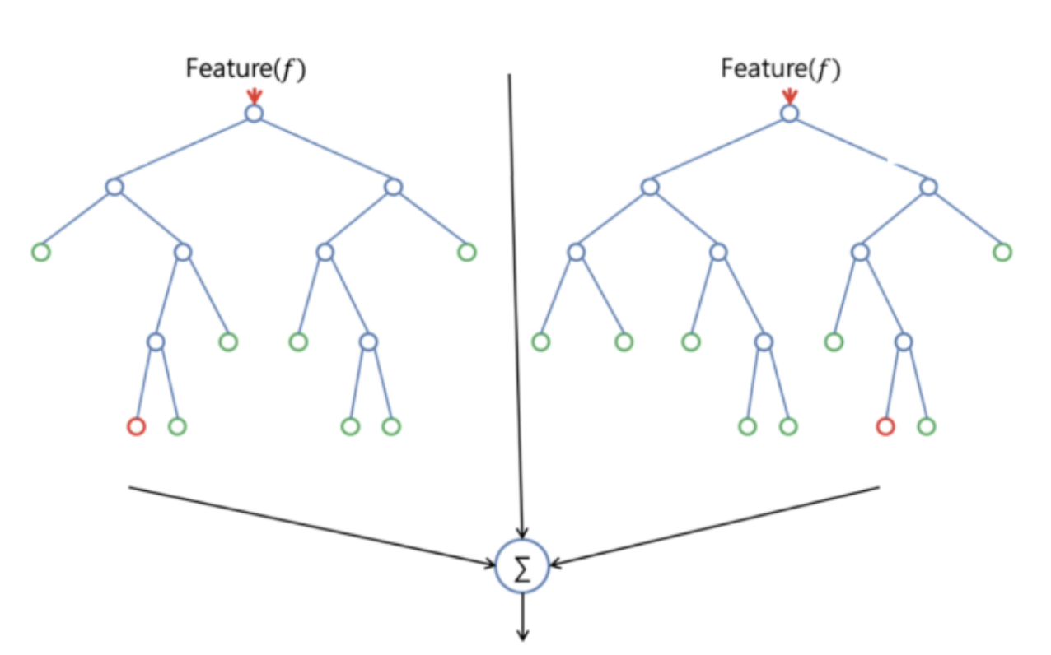
Random Forest Classifier
Supervised learning method where the “forest” it builds is an ensemble of decision trees.
Usually trained with the “bagging method”.
The general idea of the bagging method is that a combination of learning models increases the overall result.
Builds multiple decision trees and merges them together to get a more accurate and stable prediction.

Slide 18
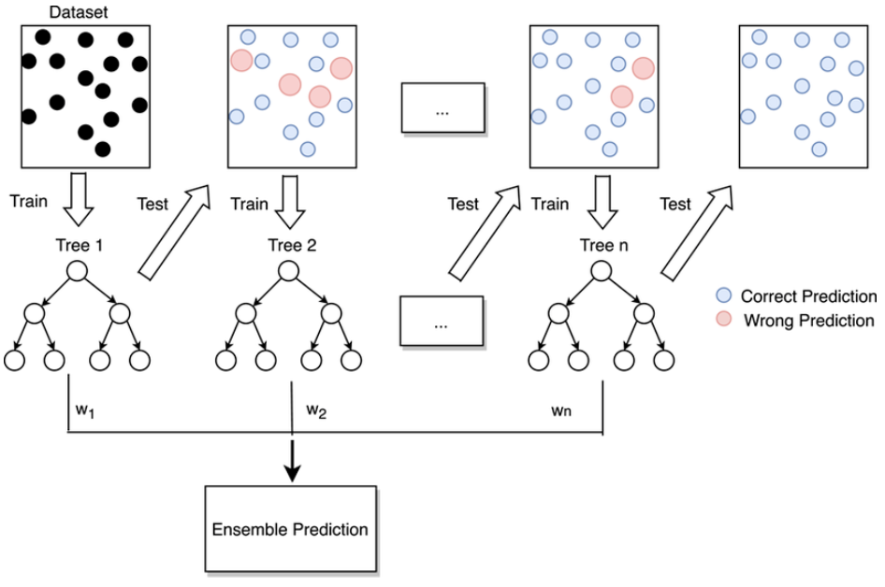
Gradient Boosting Machine Classifier
Algorithm starts by building a decision stump and then assigning equal weights to all the data points.
Increases the weights for all the points which are misclassified and lowers the weight for those that are easy to classify or are correctly classified.
A new decision stump is made for these weighted data points.

Slide 19
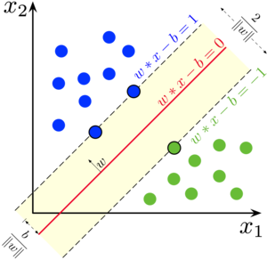
Support Vector Machine Classifier
Performs classification by constructing hyperplanes in the multidimensional space.
Based on the concept of decision planes that define decision boundaries.
Employs an iterative training algorithm, which is used to minimize an error function and is implemented using kernel.

Slide 20
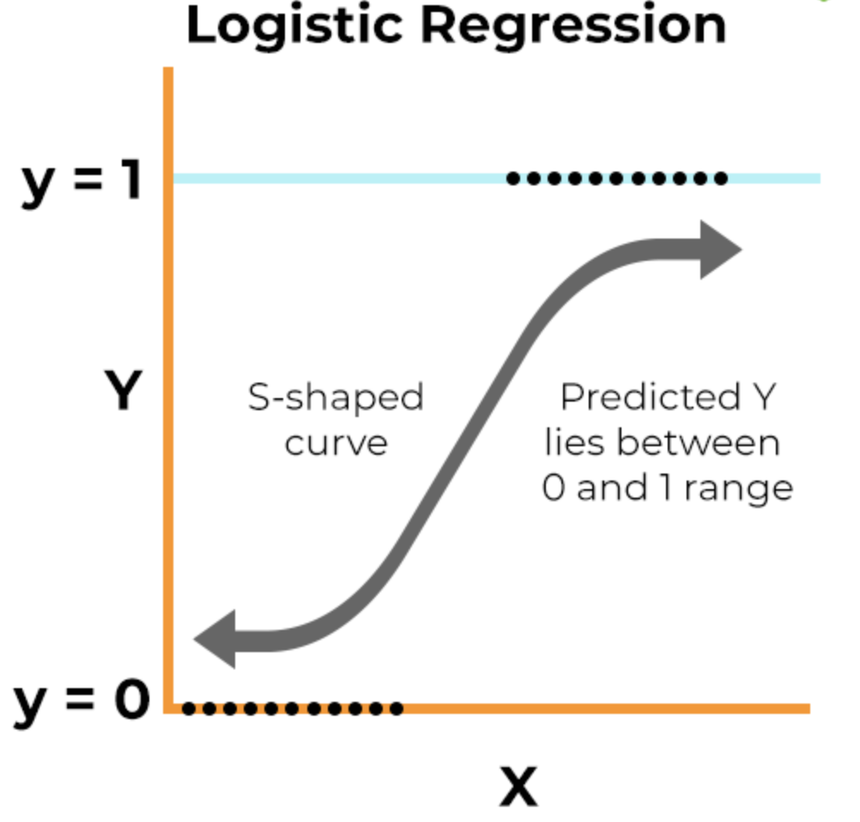
Logistic Regression
Supervised machine learning algorithm that accomplishes binary classification tasks by predicting the probability of an outcome, event, or observation.
Analyzes the relationship between one or more independent variables and classifies data into discrete classes.

